Slide 1



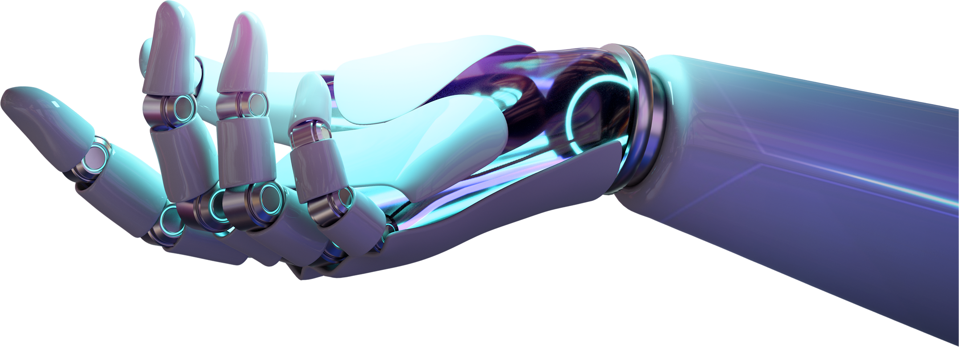


CytoAutoCluster
By Likitha Dadi
A Study of Mass Cytometry in Cells
By:- Divanshu

Slide 2

Table of Contents
01
Project Overview
02
Dataset
03
Methodologies
04
VIME Model: Variational Information Maximization Embedding model
05
Encoder
06
Result and Evaluation
07
Gradio Interface
08
Gradio Interface Demo Visualizations

Slide 3
Project Overview
CytoAutoCluster is an advanced solution for clustering cells based on unique characteristics. Using semi-supervised learning, it enhances clustering accuracy and computational efficiency, providing valuable insights into cellular data.
Key Features:
Semi-Supervised Learning: Leverages both labelled and unlabelled data to enhance clustering accuracy.
Efficient Cell Grouping: Segments cells into distinct clusters based on nuanced features.
Optimized for Performance: Handles large datasets with speed and precision.
Interpretability: Visualizes and explains cluster distributions clearly.
Scalability: Manages large, complex datasets without compromising performance.
Photo by Pexels

Slide 4

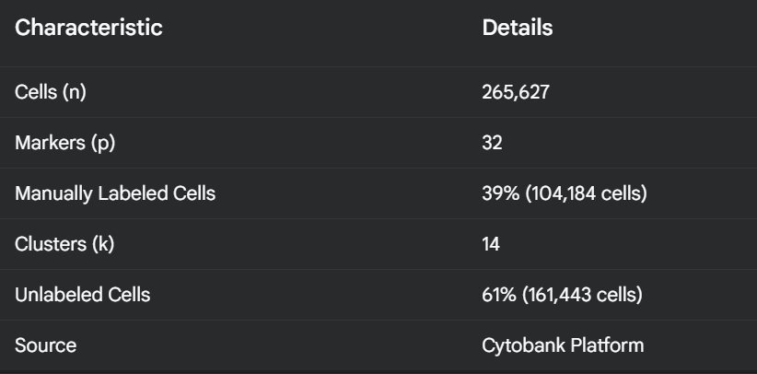
Dataset
Criteria for dataset selection:
Documentation and context.
Number of samples and feature types.
Checking for biases.
Number of Labelled and unlabelled cells
Dimensions in dataset
Photo by Pexels

Slide 5
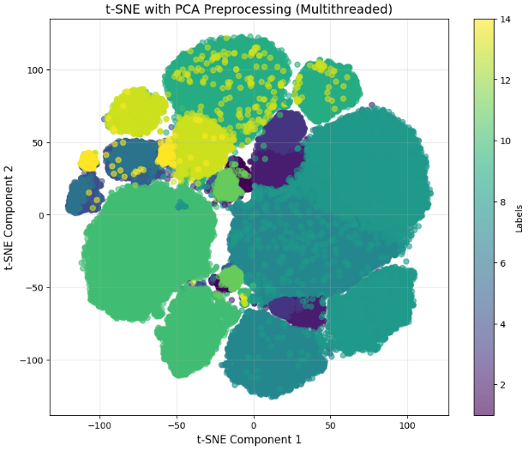
Methodoligies
EDA
Box Plot
Correlation Matrix
Kurtosis
Skewness
DIMENSIONALITY REDUCTION TECHNIQUES
PCA
t-SNE
Log Loss
DATA AUGUMENTATION
Binary Masking
Corruption data
Photo by Pexels

Slide 6
VIME Model: Variational Information Maximization Embedding model
Purpose:
Combines labeled and unlabeled data to improve performance in tabular datasets.
Key Steps:
Pretext Task: Self-supervised learning with attribute masking & reconstruction.
Fine-Tuning: Uses labeled data for specific tasks (e.g., classification).
Advantages:
Handles limited labeled data effectively.
Robust for tabular data where deep learning often struggles.
Reduces overfitting risks.

Slide 7
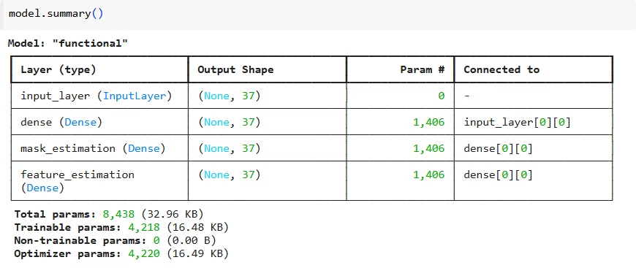
Encoder
Self-Supervised Encoder
The encoder takes 32-dimensional input, uses fully connected layers with ReLU activation, and outputs mask estimation and feature reconstruction.
Training Details
The model is trained using a batch size of 128, for 50 epochs, with loss functions including binary cross-entropy and mean squared error (MSE).
Photo by Pexels

Slide 8
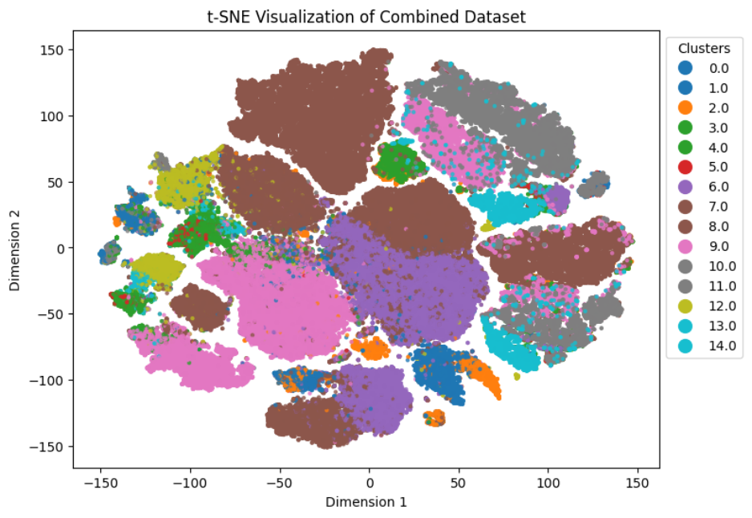
Results and Evaluation
Accuracy
The model achieved a 99.6% accuracy in self-supervised clustering, indicating its ability to identify cell types.
AUROC
The area under the receiver operating characteristic curve (AUROC) reached 99.09%, demonstrating strong predictive power.
Log Loss
Log loss for logistic regression and XGBoost were 0.0299 and 0.0039, respectively, suggesting good calibration.
Photo by Pexels

Slide 9
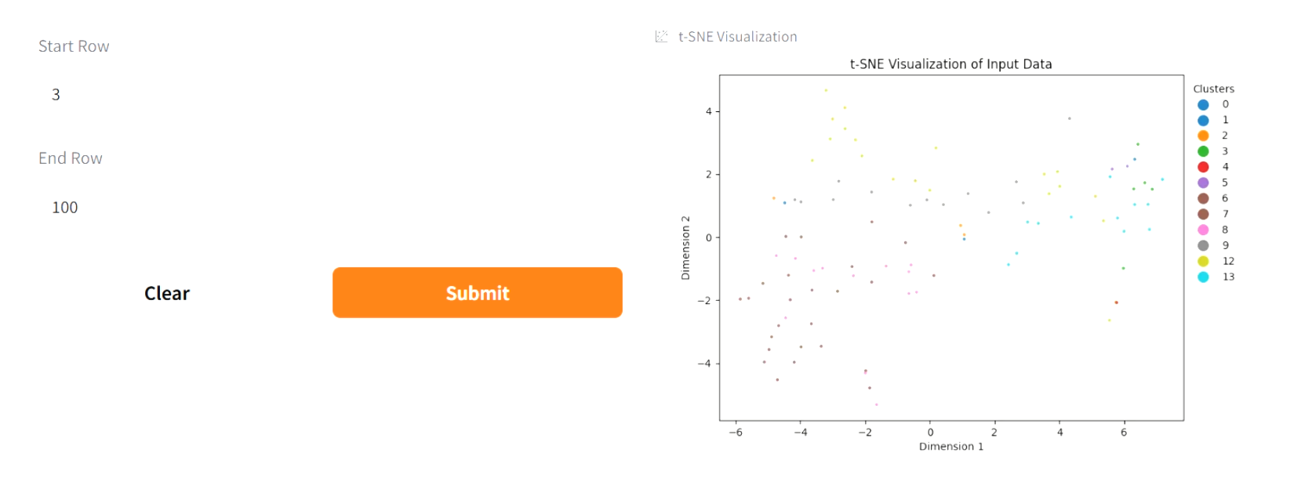
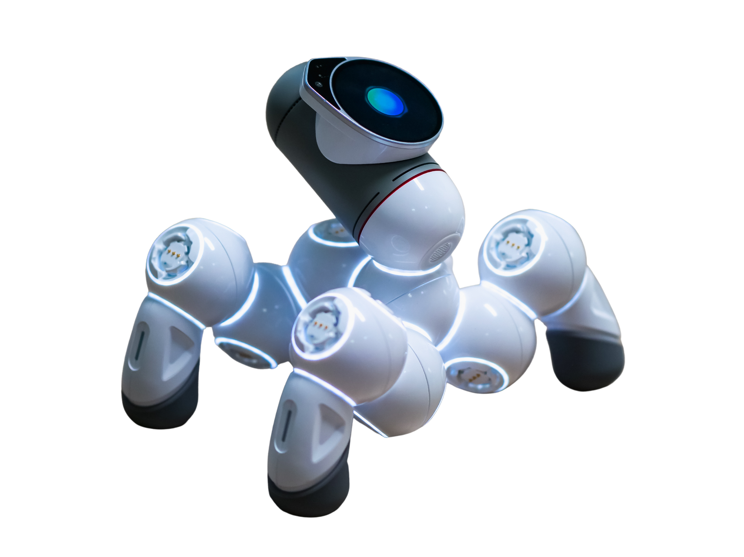
Gradio Interface
Purpose
Provides an interactive visualization and prediction tool for users.
Key Functions
Processes unlabelled data, predicts cell types, and dynamically visualizes clusters using t-SNE.
Photo by Pexels

Slide 10

Gradio Interface Demo Visualizations
The Visual Representation of Gradio Interface for our model is showcased in the below live demo video.
Live Demo Access Link :
Kindly press control then tap button to play or download video
PLAY
DOWNLOAD
Photo by Pexels

Slide 11


From:- Divanshu
Email : divanshuvaish96@gmail.com
LinkedIn : https://www.linkedin.com/in/divanshu-658a18217/
GitHub : https://github.com/Divanshu7

